Slide 2
Introduction
Testing the functionality of Advanced Driver Assistance Systems or full stack autonomous vehicles is crucial to ensure road safety
Generate critical traffic scenarios using search-based testing
A genetic algorithm will be used for the search task
Controls all NPCs in the simulation
Optimizes the cumulated emergency brake duration of the ego vehicle
Research Question 1
Is a genetic algorithm suitable for generating critical driving scenarios compared to random search?
Research Question 2
Can the performance of a genetic algorithm be improved by optimizing the control parameter using the Taguchi method?

Slide 3
Traffic Manager – TODO: Maybe remove BT…
Behaviour Tree
Traffic Manger
Genetic Algorithm
World Information
World Information
Action Interface
EGO
NPC 1
NPC 2
…
Traffic Manger simulates all vehicle
vehicles drive in then simulation in a realistic manner
Provides an interface to alter vehicles behaviour through actions such as LaneChange, JunctionSelection, ModifyTargetVelocity, etc …
Genetic Algorithm optimizes the cost function by directing NPC vehicles through specified actions.
Behaviour Tree guides EGO vehicle by setting actions
Sets different junction selections and avoiding blocking obstacles through lane changes in order to create more interesting scenarios

Slide 4
Genetic Algorithm Implementation
Inspired by Natural Selection:
Modeled after the process of natural selection in biology.
Mimics the principles of evolution to find optimal solutions.
Population-Based Optimization:
Operates on a population of potential solutions.
Utilizes genetic operators like crossover and mutation for reproduction.
Iterative Improvement:
Solutions evolve over multiple generations.
Fitness function guides the selection of better solutions, leading to convergence.
Gene and Chromosome:
A chromosome and its genes form a solution to the search problem
Custom encodings for Genes and Chromosomes are required to describe a search solution

Slide 5
Chromosome encodings
Time Encoding
0
1
2
3
4
5
6
7
8
9
10
11
12
13
14
15
16
17
18
19
Corresponds to timestep 1 (0.5 seconds)
Action NPC 1
Action NPC 2
…
Action NPC n
Time+NPC Encoding
NPC 1
NPC 2
NPC 3
0
1
2
3
4
5
6
7
8
9
0
1
2
3
4
5
6
7
8
9
0
1
2
3
4
5
6
7
8
9
Corresponds to timestep 1 (0.5 seconds)
Action NPC 1

Slide 6
Time Encoding – One Point Crossover
0
1
2
3
4
5
6
7
8
9
10
11
12
13
14
15
16
17
18
19
0
1
2
3
4
5
6
7
8
9
10
11
12
13
14
15
16
17
18
19

Slide 7
Time+NPC Encoding - One Point Crossover
0
1
2
3
4
5
6
7
8
9
0
1
2
3
4
5
6
7
8
9
0
1
2
3
4
5
6
7
8
9
0
1
2
3
4
5
6
7
8
9
0
1
2
3
4
5
6
7
8
9
0
1
2
3
4
5
6
7
8
9

Slide 8
Hyperparameter Tuning – Literature review
Literature review
8 different hyperparameter combinations used by existing literature were tested over 5 repetitions
Population size was varied over values 32, 48, 64 and 96
A population size of 96 was the most robust
Design of Experiment:
Systematic approach for process optimization.
Identifies factors impacting performance.
Introduction to Taguchi Method:
Developed by Genichi Taguchi for robust optimization.
Key Taguchi Concepts:
Signal-to-Noise Ratio, Orthogonal Arrays, Control & Noise Factors.
Advantages of Taguchi Method:
Robustness, Cost-Efficiency, Simplicity.

Slide 9
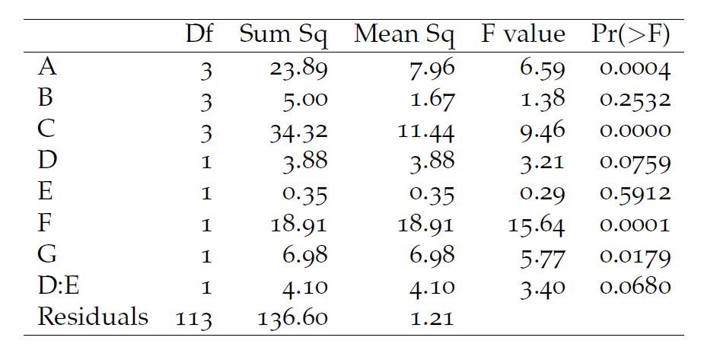
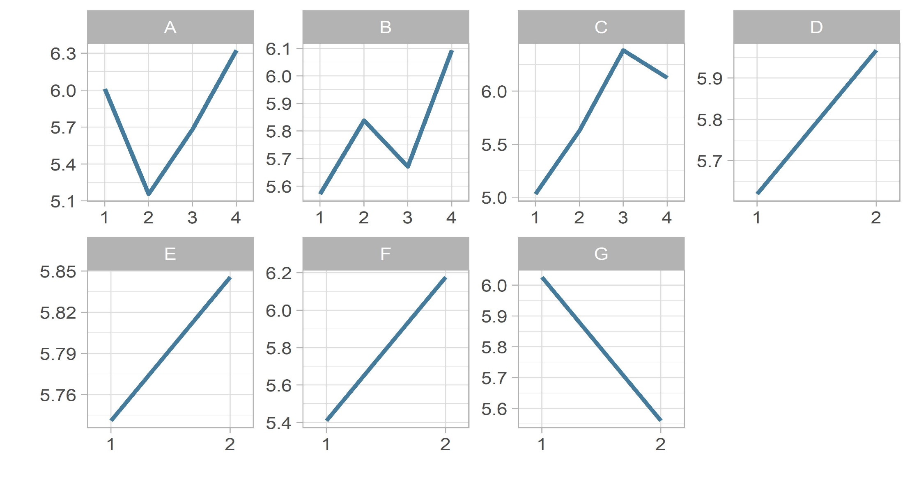
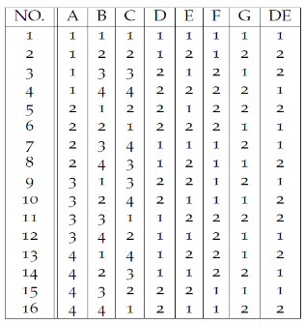
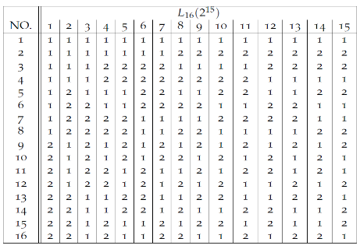
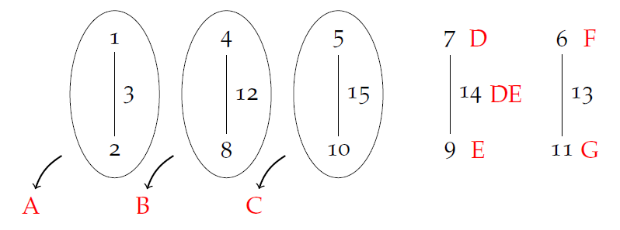
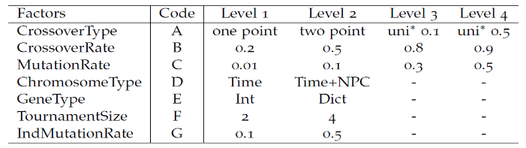
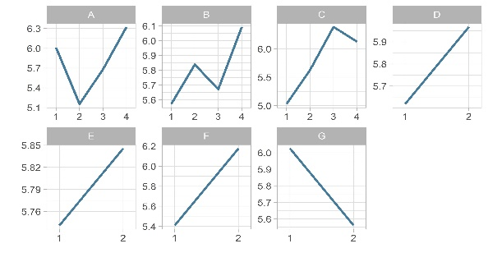
Taguchi Method – Step by Step
Factor and Level Selection
L₁₆ orthogonal array
Linear Graph
Run experiment using modified L₁₆ array
ANOVA
Main and Interaction Effects

Slide 10
Comparison of Default vs Optimized Settings
Settings | Default | Optimized
PopulationSize | 96 | 96
CrossoverType | Two Point | Uniform 0.5
CrossoverRate | 0.8 | 0.9
MutationRate | 0.2 | 0.3
ChromosomeType | Time | Time+NPC
GeneType | Integer | Integer
TournamentSize | 4 | 4
IndMutationRate | 0.1 | 0.1

Slide 11
Evaluation
Comparison between:
Optimized Genetic Algorithm
Default Genetic Algorithm – uses best values from the literature review
Random Search
For each algorithm
4 different start scenarios
10 repetitions per start scenario
2976 simulations per repetition
Goals
Test if Optimized is than random (research question 1)
Test if Optimized is better than default (research question 2)
Analyse if Optimized can generalize on different start scenarios where it has not been optimized on

Slide 12
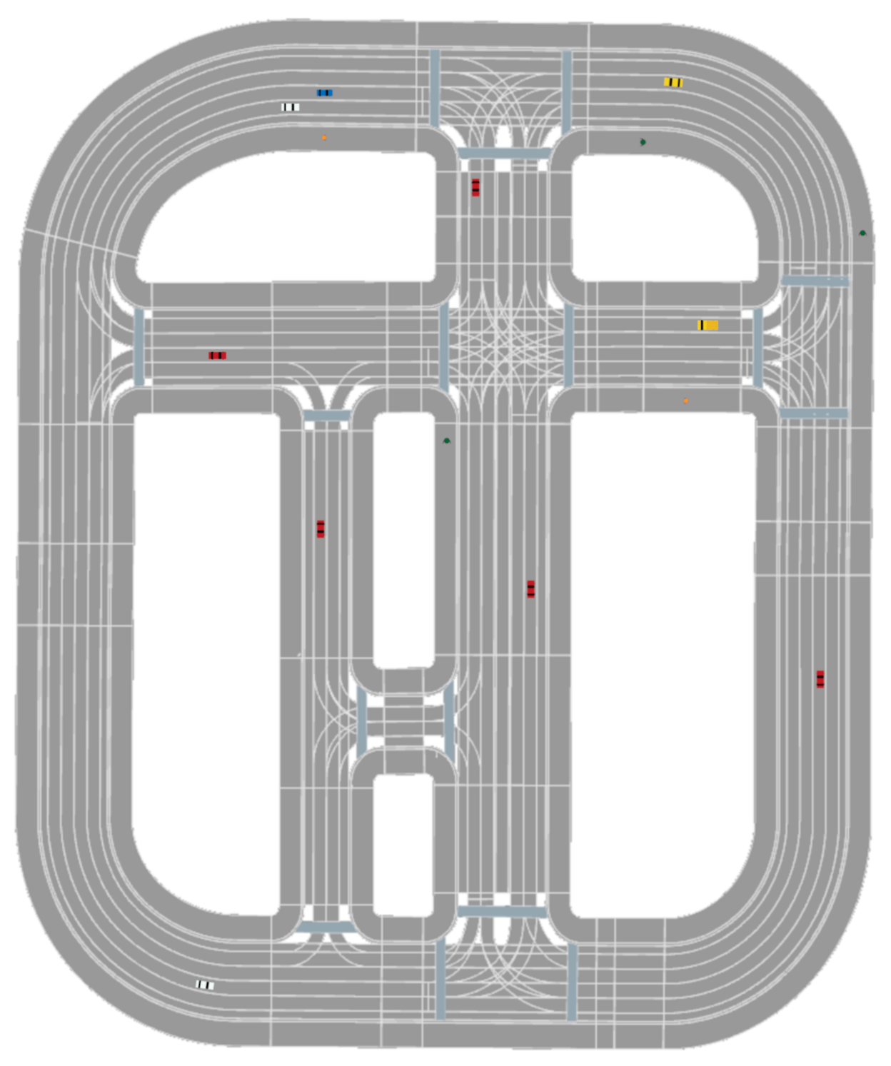
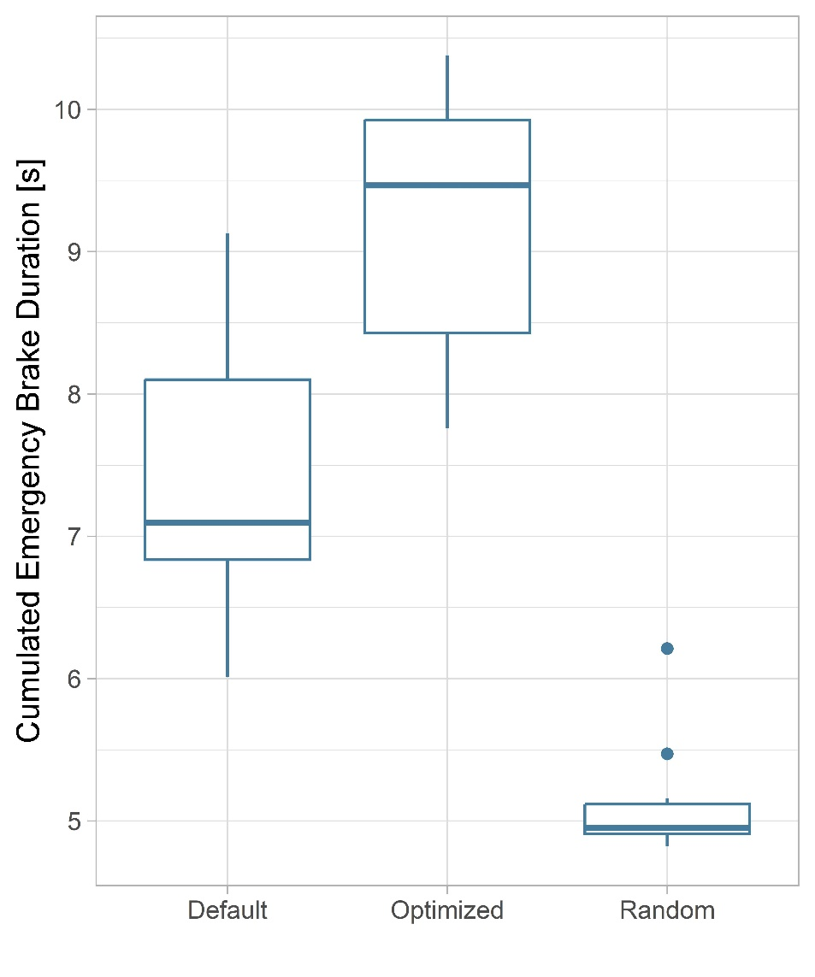
Evaluation: Start Scenario 2

Slide 13
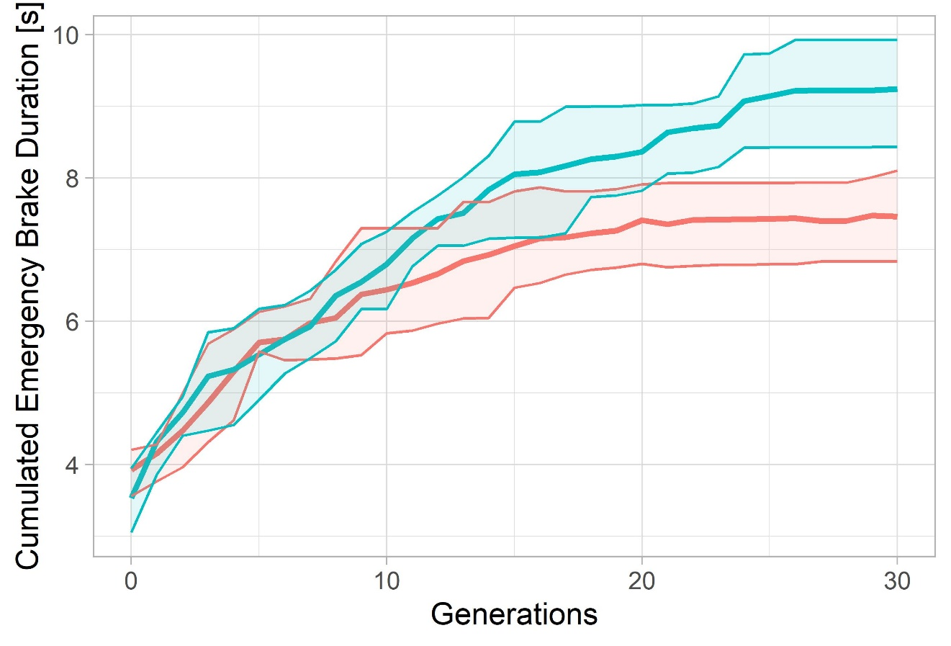
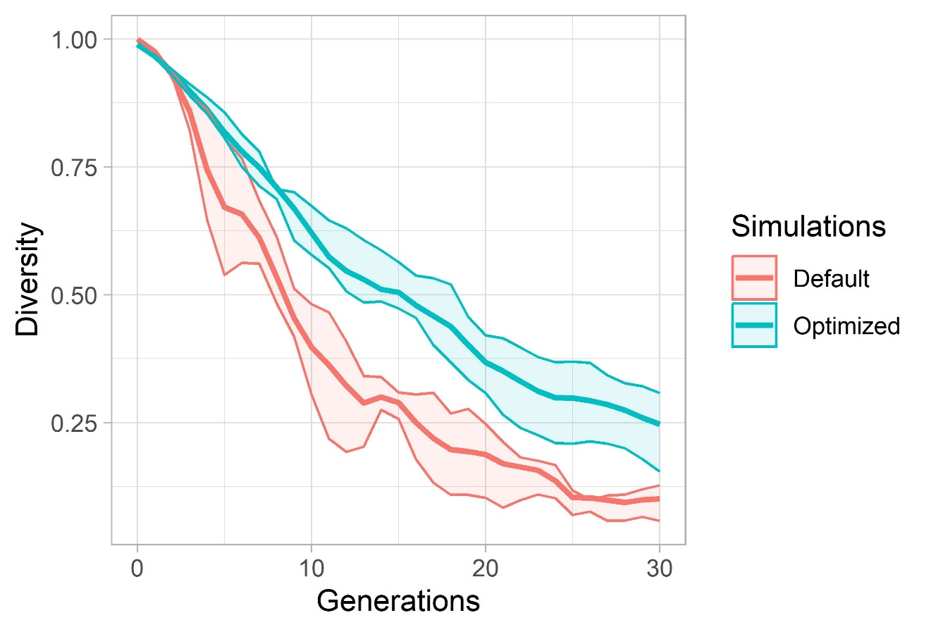
Evaluation: Start Scenario 2

Slide 14
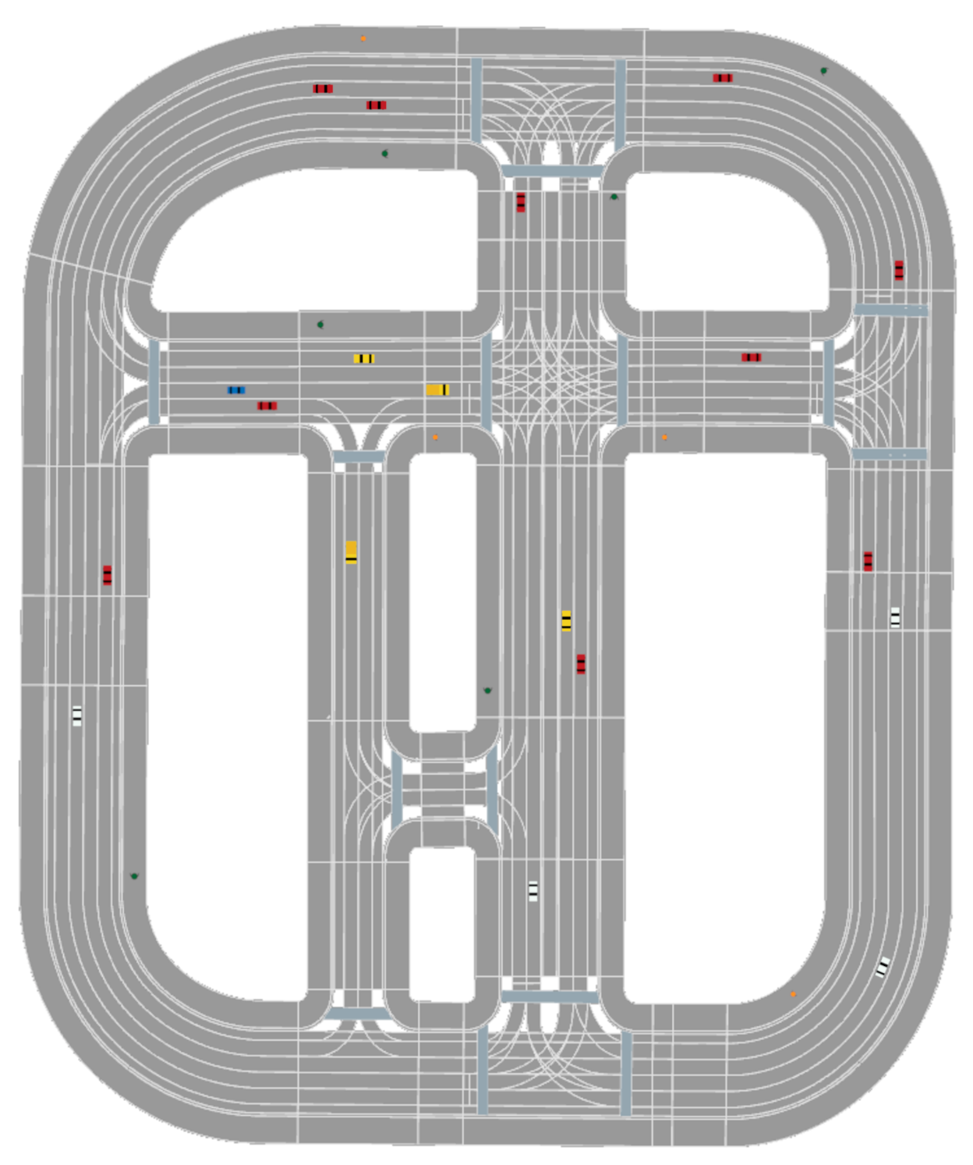
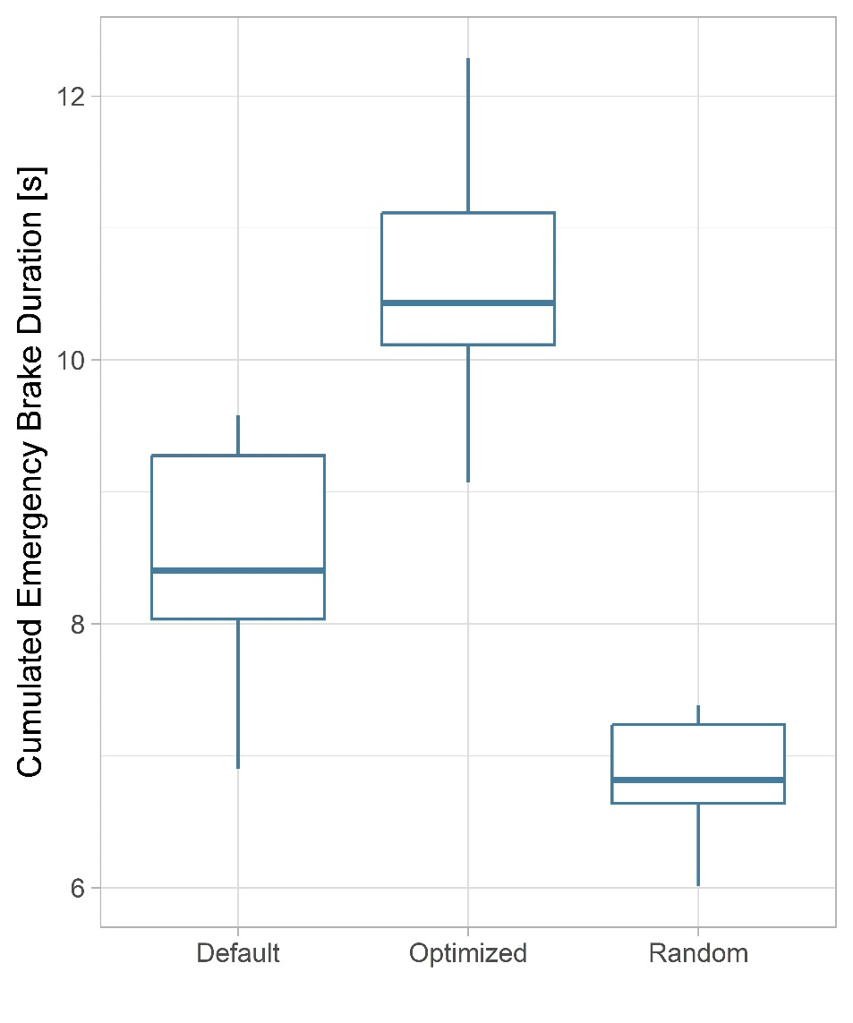
Evaluation: Start Scenario 4

Slide 15
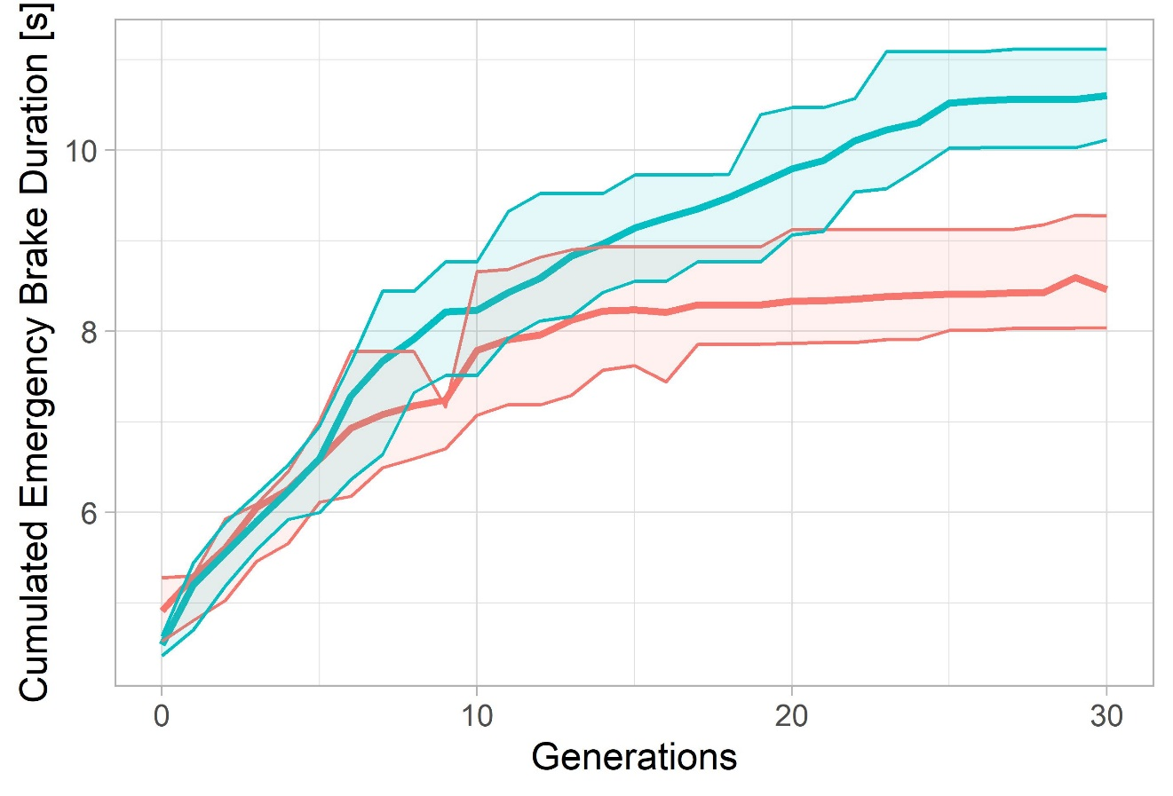
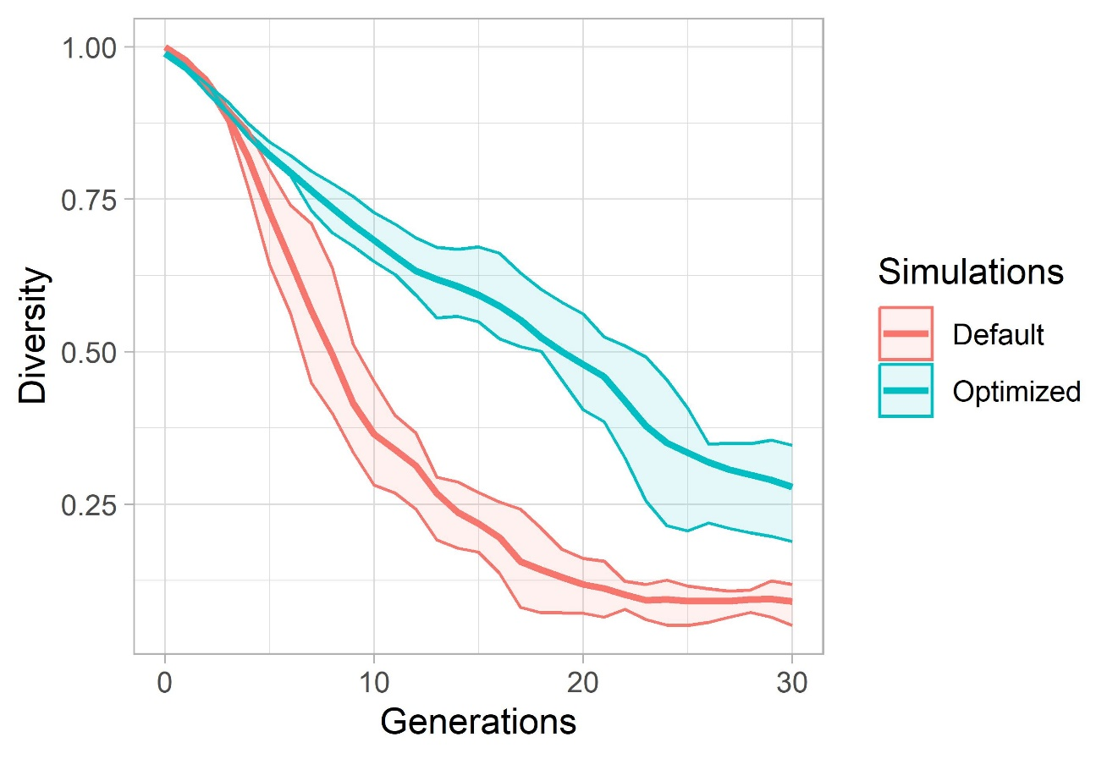
Evaluation: Start Scenario 4

Slide 16
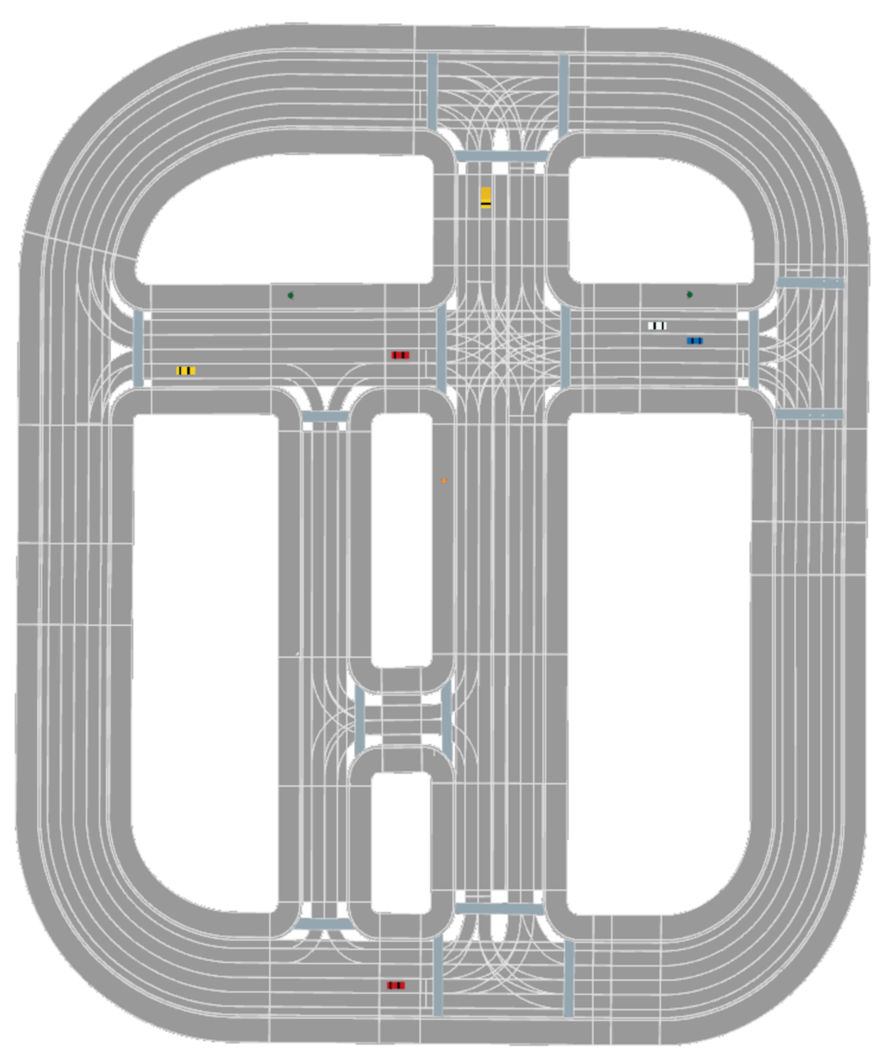
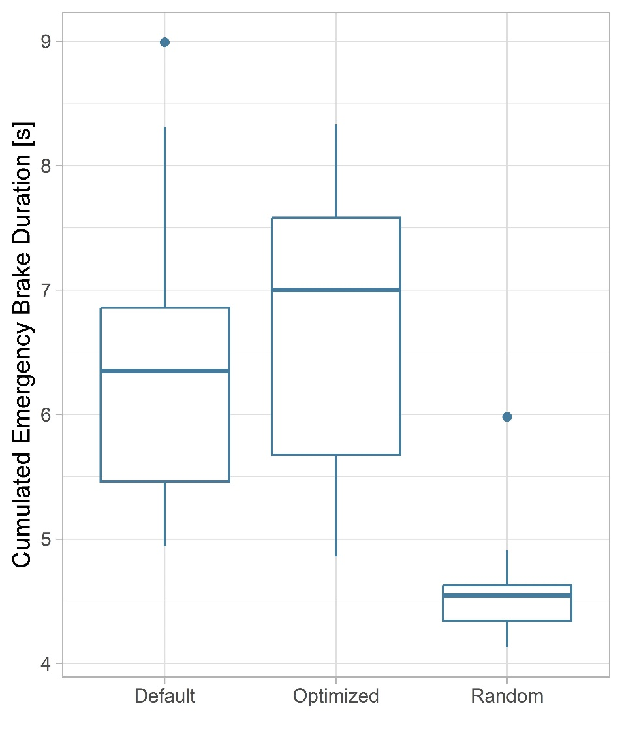
Evaluation: Start Scenario 3

Slide 17
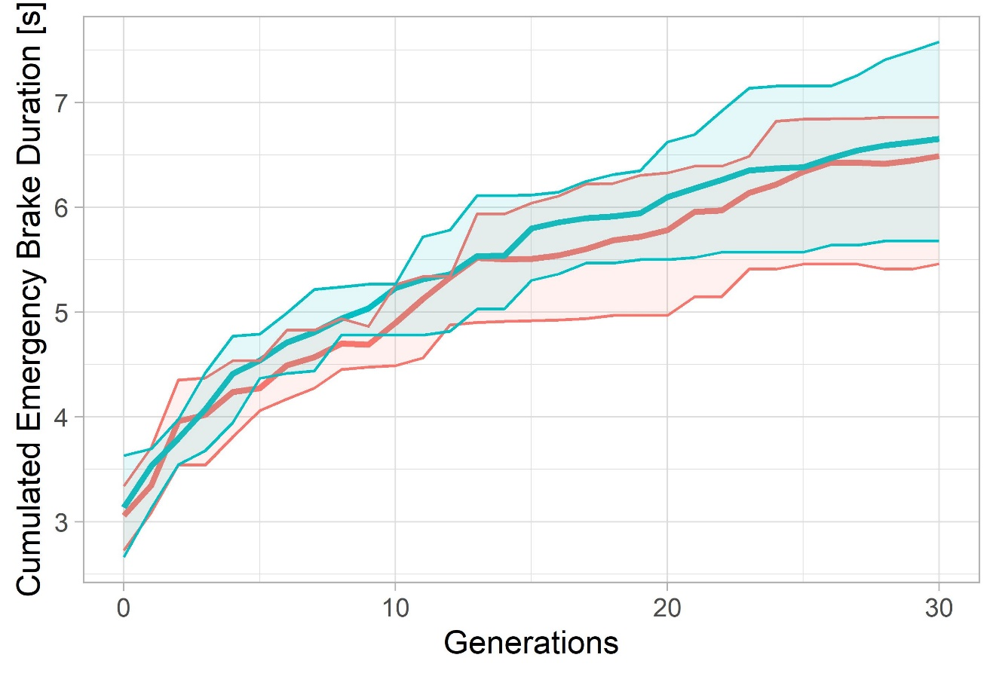
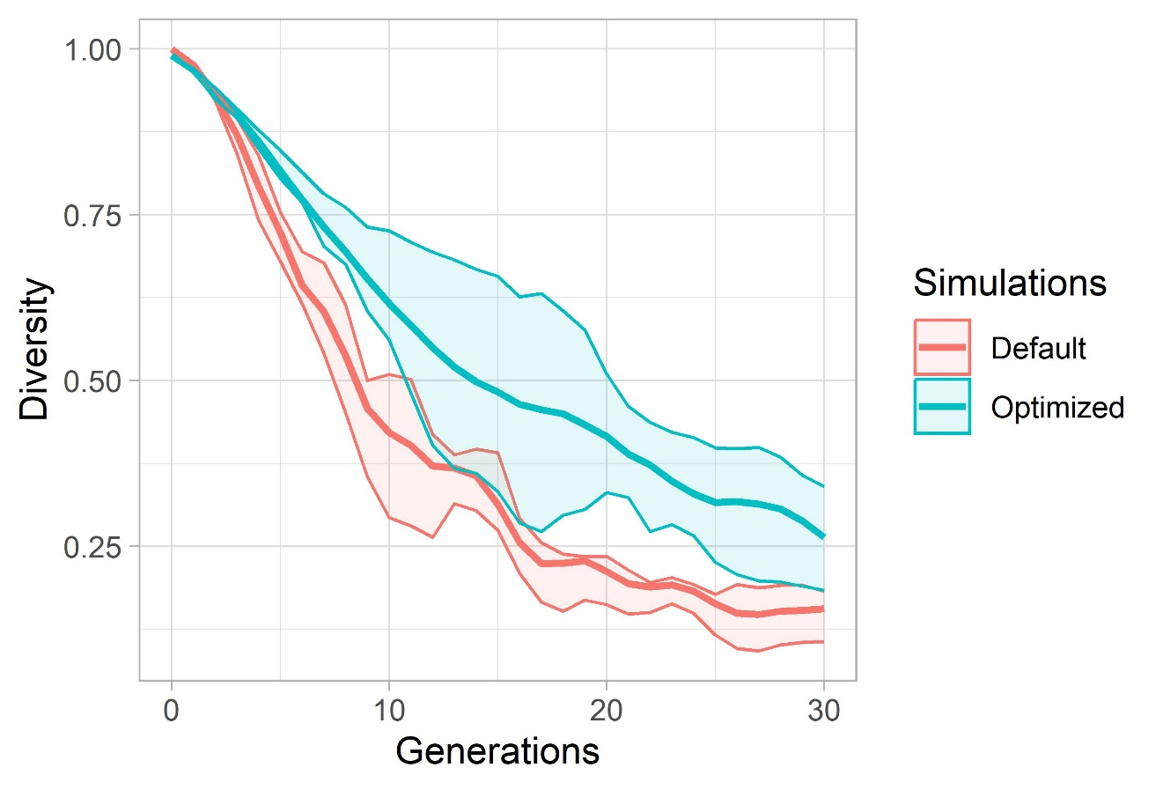
Evaluation: Start Scenario 3

Slide 18
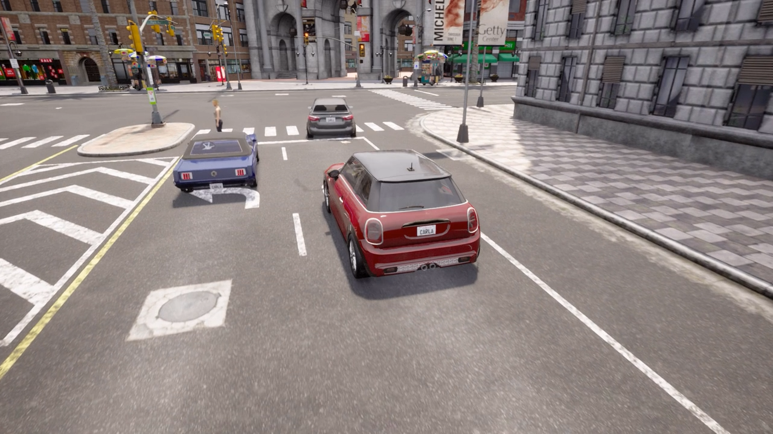
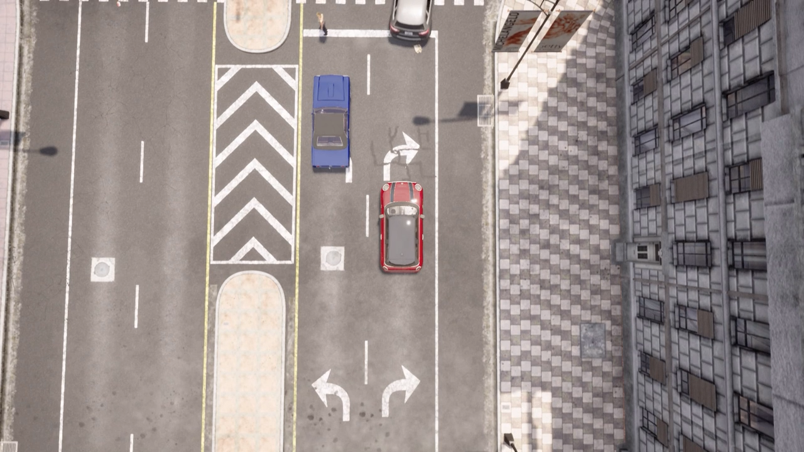
Critical Situation 1 – Scenario 1 - Carla
After pedestrian crossing
NPC vehicle cuts shortly before junction and violates path of EGO vehicle (blue)
EGO vehicle must perform an emergency break

Slide 19
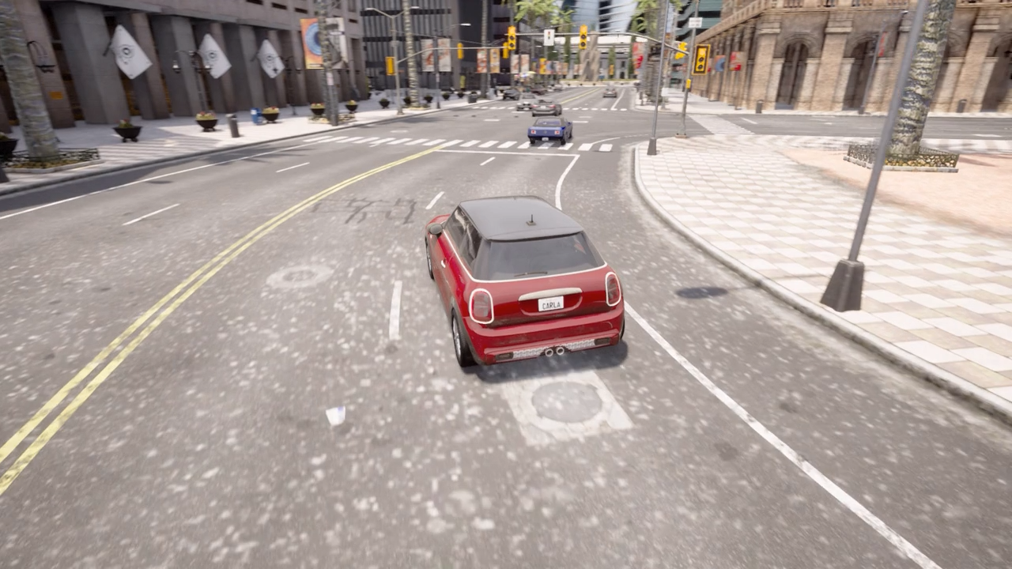
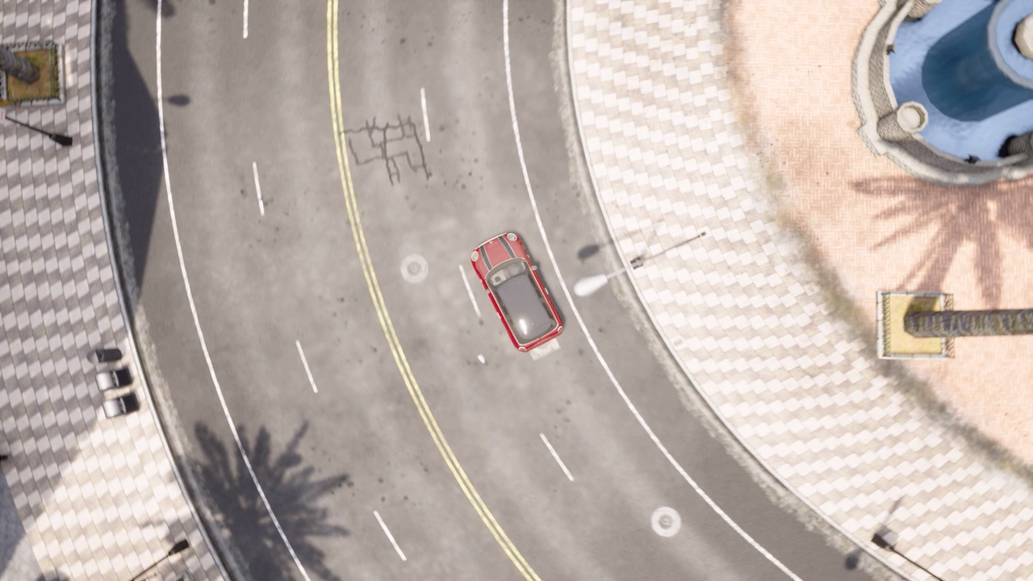
Example videos – rendered in Carla
Inside junction
NPC vehicle ignores right of way
EGO vehicle (blue) must perform emergency break to avoid crash

Slide 20


Example videos – rendered in Carla
Kid runs over road
Kid is occluded by Truck
EGO vehicle (blue) has to emergency break

Slide 22
Gene Encoding
Encode as Integer
0 = NoAction
1 = JunctionSelection(straight)
2 = JunctionSelection(left)
3 = JunctionSelection(right)
4 = LaneChange(left, 3)
5 = LaneChange(right, 3)
6 = AbortLaneChange()
7 …
Encode as dictionary
{"type": "LaneChange", "direction": "left", "duration": 3}
{"type": "JunctionSelection", "junction_selection_angle": "straight"}
{"type": “AbortLaneChange"}
{"type": “ModifyTargetVelocity“, “percentage“: “133.4”}

Slide 23
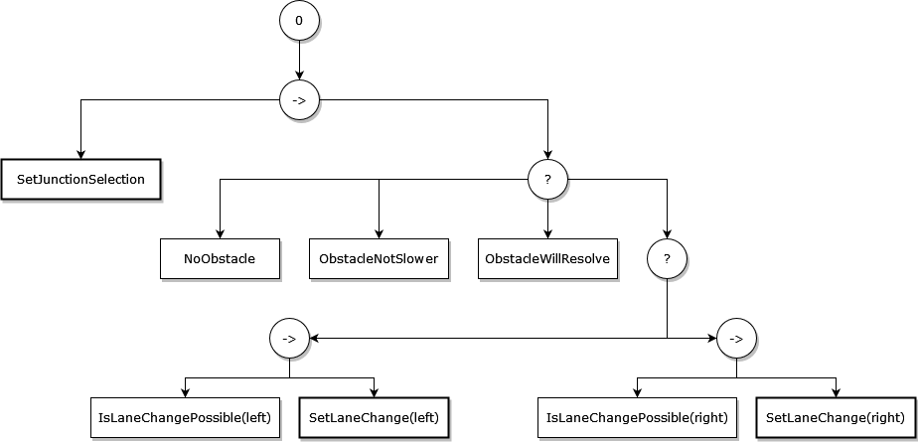
Behavior Tree

Slide 24
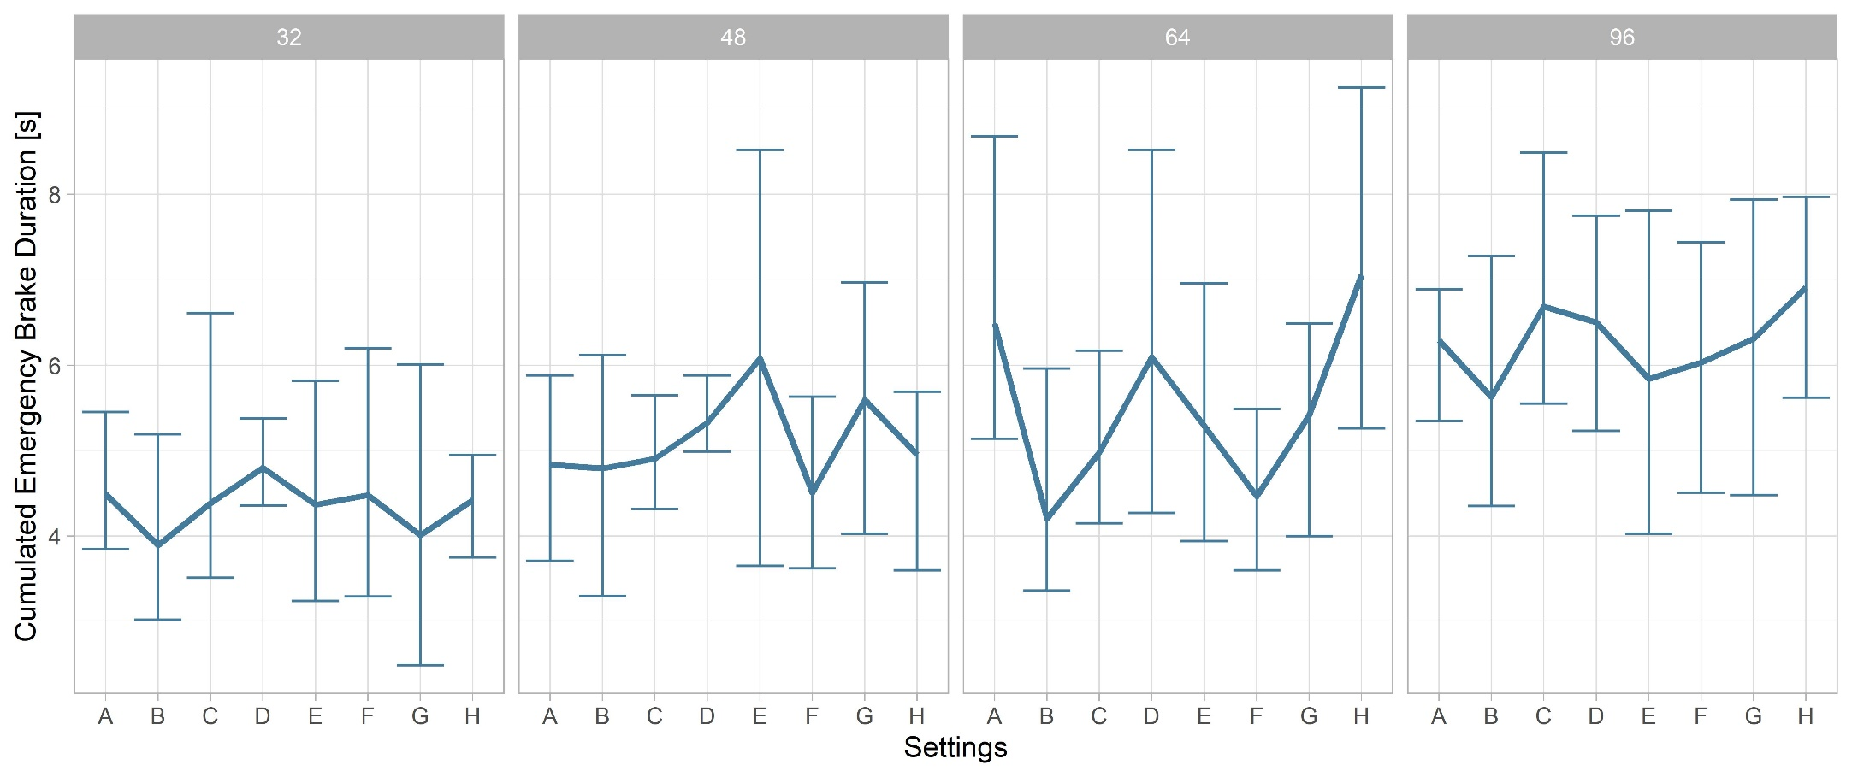

Slide 25
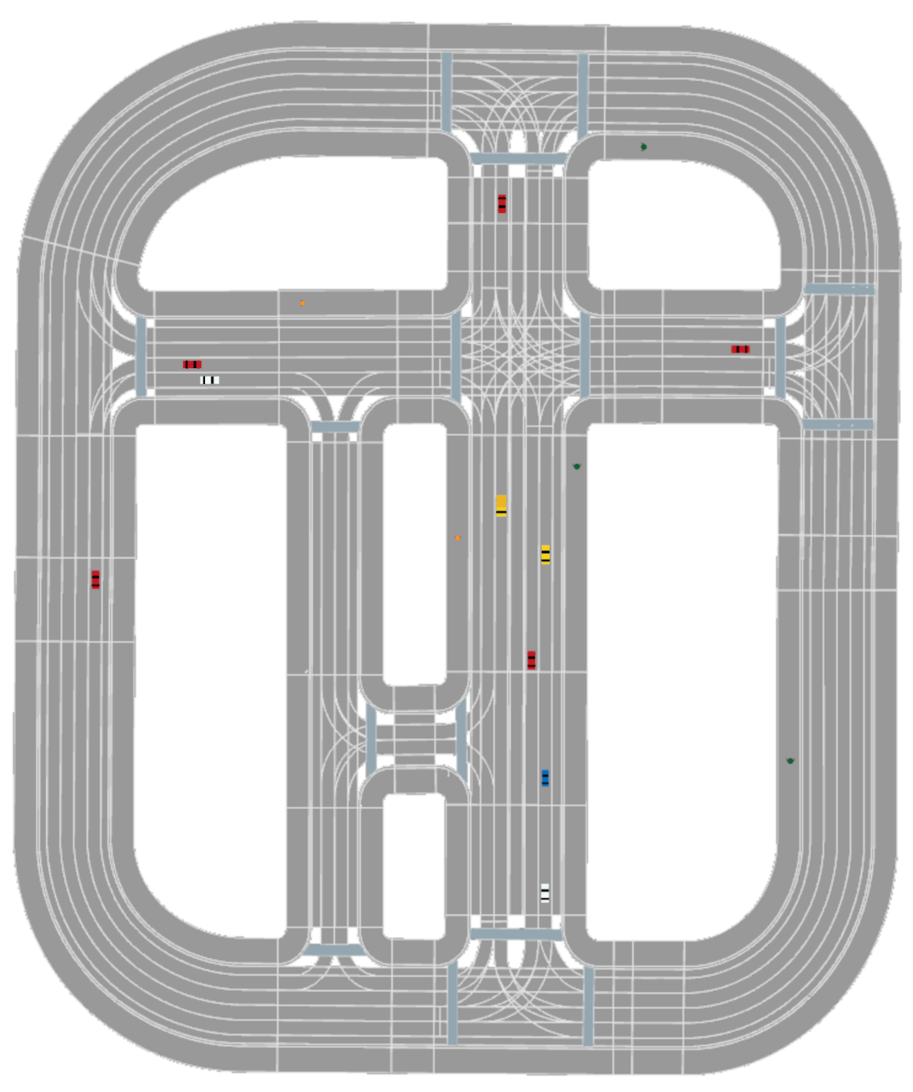
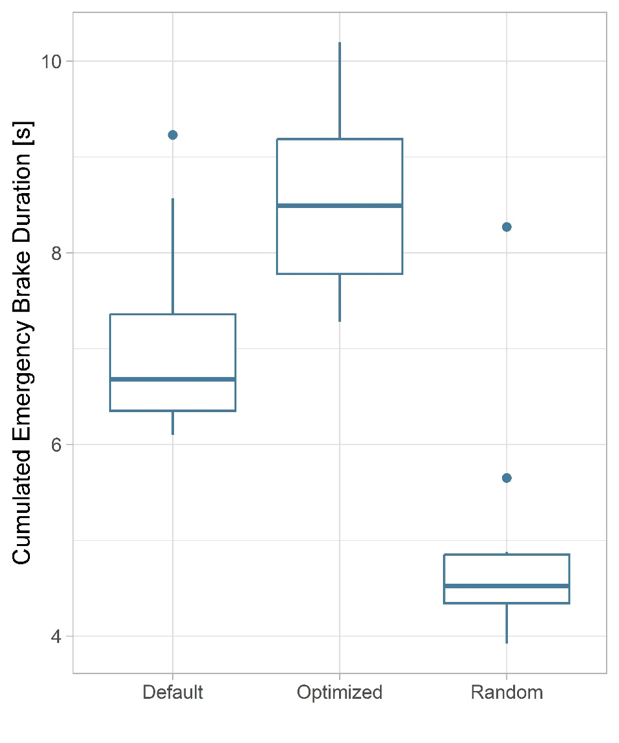
Evaluation: Start Scenario 1

Slide 26
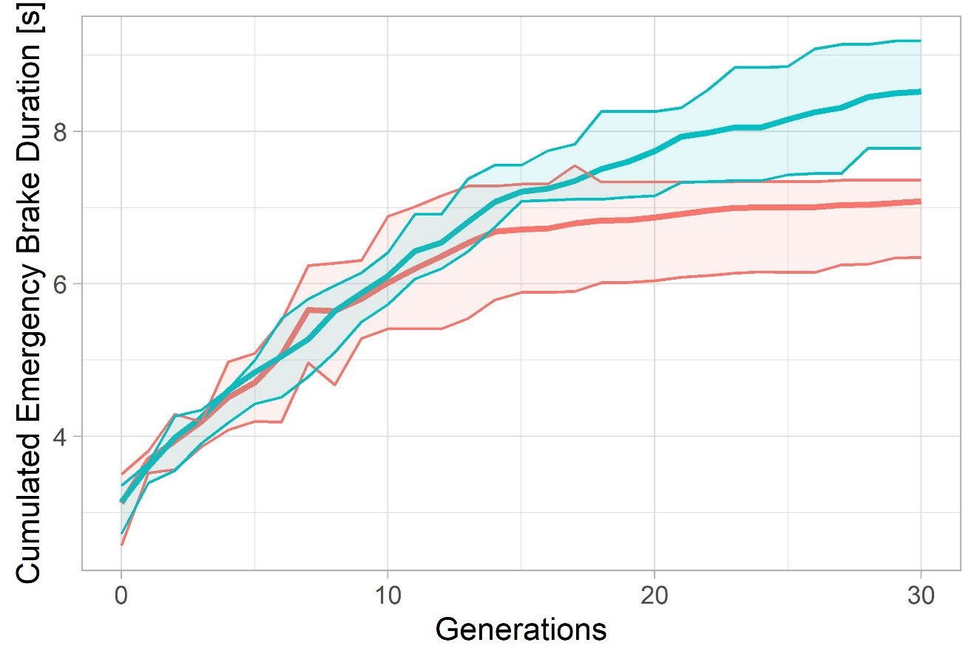
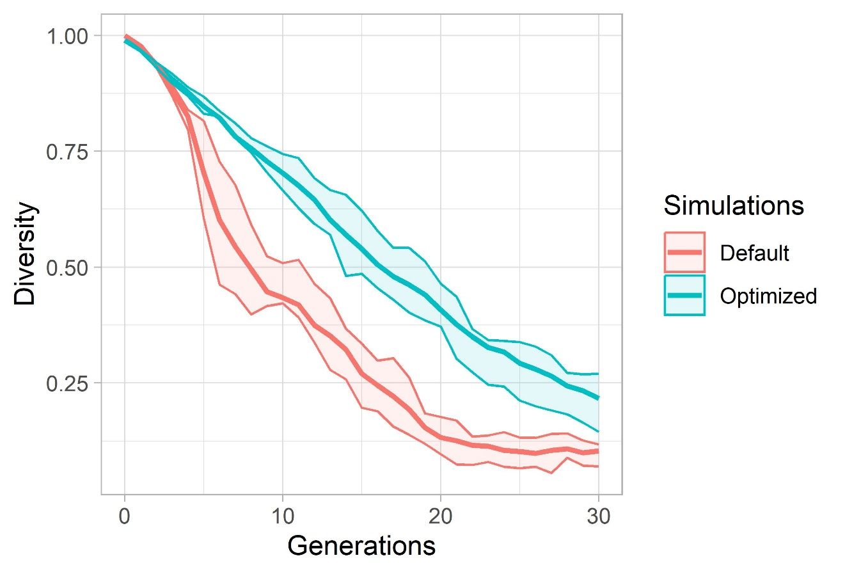
Evaluation: Start Scenario 1

Slide 27
ADD: pop size results
Add: all actions

